Slide 1
26th Dec,2024
Single Threaded Synchronous Web-Server Using C++
Project Members:
Muhammad Ahmed
Kumail Ahmed

Slide 2
Backstory | Motivation
Title:
Why Build a Web Server?
Motivation:
To understand OOP concepts in a real-world context.
To learn how Internet works
Learn practical socket programming in C++.
Explore inheritance, encapsulation, and polymorphism in a project.
Why This Topic?
Web servers are fundamental to internet communication.
Webservers are the base of internet

Slide 3
Applicability
01
02
Benefits:
Use Cases:
Serving static websites.
Teaching foundational web technologies.
Exploring efficient socket programming.
Scale existing code to apply in real world and host functional websites
Hands-on understanding of HTTP and TCP/IP protocols.
Extendable design for dynamic web applications.

Slide 4
Tools | Libraries | Platform Used
Language: C++
Libraries:
WinSock2 for socket programming.
Platform: Windows OS
IDE: Microsoft Visual Studio
Additional Resources:
HTML, CSS, JavaScript for web content.

Slide 5
Flowchart of the System
Flowchart Description: Client sends HTTP request. Server accepts and parses the request.
Checks file existence
File found: Serve file with HTTP 200.
File not found: Serve HTTP 404.
Client receives response

Slide 6
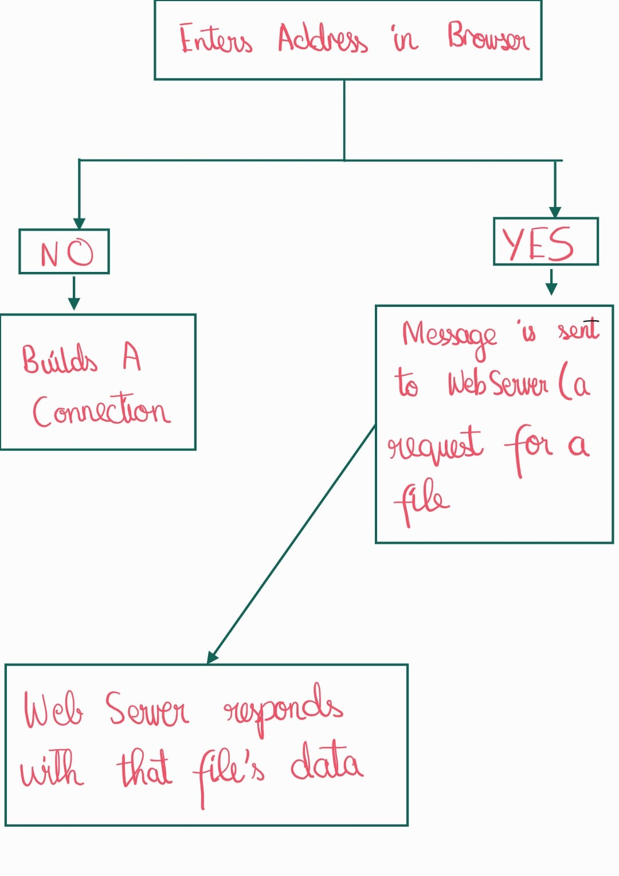
Flowchart of the System

Slide 7
Code Highlights
Title: Key Features of the Code
Abstraction
Encapsulation: Socket management in private members of TcpListener Inheritance: WebServer extends TcpListener to handle HTTP-specific tasks Polymorphism:
Virtual methods in TcpListener overridden in WebServer
Important Functions:
init() - Initializes socket and binds to an IP and port
run() - Main loop for handling connections and requests
onMessageReceived() - Parses and responds to HTTP requests

Slide 8
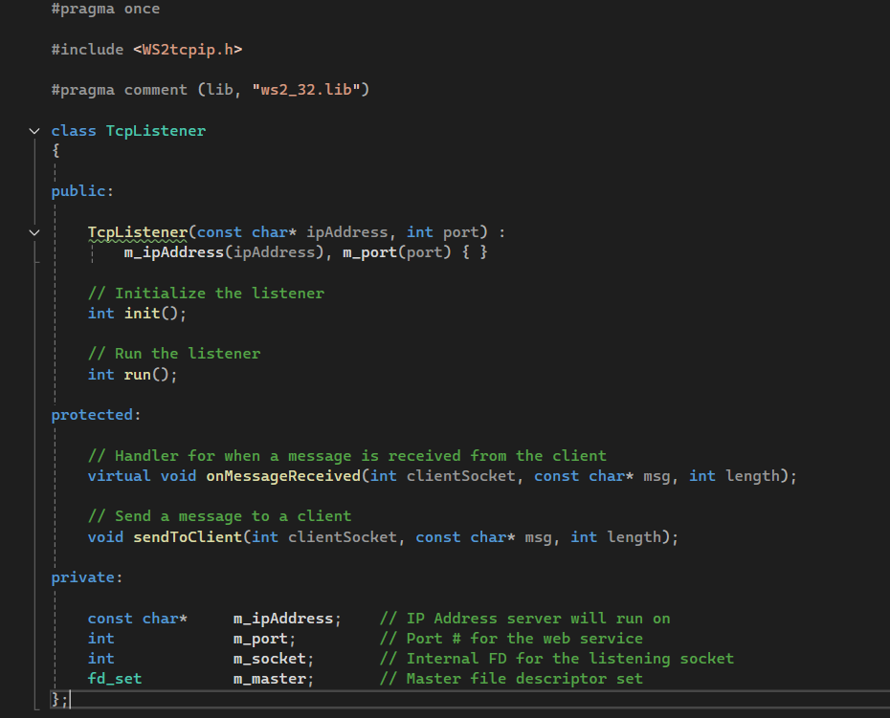
Base class: TCP listener
What it does?
init():
Initializes winsock
Creates a socket
Bind address to the socket
Open a listening socket
run():
Checks active sockets
Make a client socket if it doesn’t exist already
Receive data if connection is active
After server is closed, remove all sockets and cleanup winsock

Slide 9
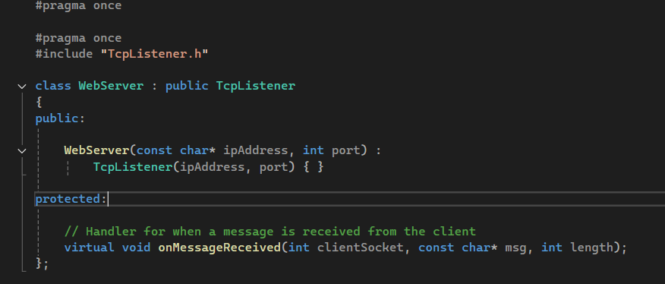
Child class: Webserver
What it does?
onMessageRecieved():
Gets the name of file requested
Opens that file (and closes it after reading it into buffer)
Send the data (website contents)to the client

Slide 10
Code Standards
Title: Adherence to Standards
Naming Conventions:
Classes: PascalCase (e.g., WebServer).
Methods: camelCase (e.g., onMessageReceived).
Variables: descriptive, lowercase.
Coding Standards:
Proper use of const and inline.
Comments for all methods and key logic.
Formatting:
Consistent indentation.
Organized file structure.

Slide 11
Conclusion
Takeaways
Object-oriented principles in action.
Practical implementation of a web server.
Enhanced understanding of networking concepts.

